Slide 1

Machine Learning based Analysis of Cryptocurrency Market Financial Risk Management
Team 3: 1.B. Sai Charan (21R01A6678)
2.K. Ashwini (21R01A6689)
3.KB. Aakash (21R01A6690)
Guide: Dr. L. Arokia Jesu Prabhu
Assoc Prof, CSE (AI&ML)
CMRIT, Hyderabad.

Slide 2

INTRODUCTION
The analysis of cryptocurrency market financial risk management has gained significant attention due to the rapid growth and volatility of digital assets like Bitcoin, Ethereum, and thousands of other cryptocurrencies.
Unlike traditional financial markets, cryptocurrencies operate in a decentralized, unregulated environment, presenting unique challenges and risks for investors, institutions, and regulators.
Financial risk management in cryptocurrency markets aims to identify, assess, and mitigate these risks to ensure market stability and protect investments.
Given the complexity and dynamism of the cryptocurrency ecosystem, traditional risk management tools are often inadequate.
Therefore, advanced technologies like machine learning (ML) and artificial intelligence (AI) have been increasingly applied to enhance risk assessment, portfolio optimization, and fraud detection in the crypto space.

Slide 3
ABSTRACT
It refers to the use of advanced machine learning (ML) algorithms and techniques to identify, assess, and mitigate the risks associated with cryptocurrency markets.
Given the volatile, decentralized, and often unpredictable nature of cryptocurrencies, traditional risk management tools are insufficient.
A sophisticated method that organizes cryptocurrency portfolios by the usage of Hierarchical Risk Parity(HRP), Reinforcement Learning based systems.
The model faced several difficulties with generalized data availability and quality, security and anonymity concerns, and scalability issues.
To improve these work on risk management we approach a robust model with Hierarchical Risk Parity that gives the better output in term of returning the adjusted risk tail to get the better risk management result.

Slide 4
LITERATURE SURVEY
S.NO | Title of the Paper | Publication and Year | Author | Methodology or Algorithm | Inference
1 | Effects of Cryptocurrency in Tail Risk Network during COVID-19 | International Research training group 2020 | Rui Ren | Duality problem of cryptocurrency market | Identifying the characteristics of individual risk and obtain the network topology by spillover effects
2 | Cryptocurrency Regularity Risk Index Based on Machine Learning | Wolfgang Karl Härdle, 2021 | Xinwen | Market risk based on changes of regularity | Analyzing the market impact of originating the risk for the new regulation
3 | Investing the risks and returns of cryptocurrencies | The Review of Financial Studies, 2021 | Debi Eka | Only focus on legal statement | Measurement of risks based on heteroscedastic model
4 | Return and Risk Analysis on Cryptocurrency Assets | Kontigensi: Scientific Journal of Management 2022 | Sakina Ichsani | Analyzing the return and risk of specific cryptocurrency assets | Summarize the average return and volatility of each cryptocurrency

Slide 5
PROBLEM STATEMENT
The cryptocurrency market, known for its high volatility and unpredictability, poses significant financial risks to investors and traders.
Traditional risk management approaches struggle to adapt to the crypto market's rapid fluctuations and unique characteristics.
This project aims to leverage machine learning to analyze historical cryptocurrency data, identify critical risk factors, and develop predictive models for assessing potential financial risks. By creating a framework for proactive risk management, the project seeks to support more informed decision-making, mitigate potential losses, and contribute to the stability of investments in the cryptocurrency sector.

Slide 6
METHODOLOGY
Data Collection - Collected historical cryptocurrency market data from sources like Kaggle, GitHub etc.
Data Preprocessing - Cleaned the dataset to handle missing values and outliers. Engineered features such as price change percentages and volatility measures.
- Normalized data for consistency across features.
Exploratory Data Analysis (EDA) - Conducted EDA to identify trends and correlations using visualization techniques.
- Analyzed historical price trends and volatility to uncover key risk factors.
Model Selection and Training - Selected machine learning algorithms suitable for the analysis, such as Naive Bayes, SVM, logistic regression and decision trees.

Slide 7
Risk Prediction and Analysis - Implemented models to predict financial risk levels, classifying periods of high and low risk. Evaluated model performance using accuracy, precision, recall and F1 score.
Results Visualization - Visualized model predictions against actual data using graphs and charts to highlight findings and trends.
Evaluation and Validation -Conducted cross-validation for model robustness and compared results with benchmarks to validate effectiveness.

Slide 8
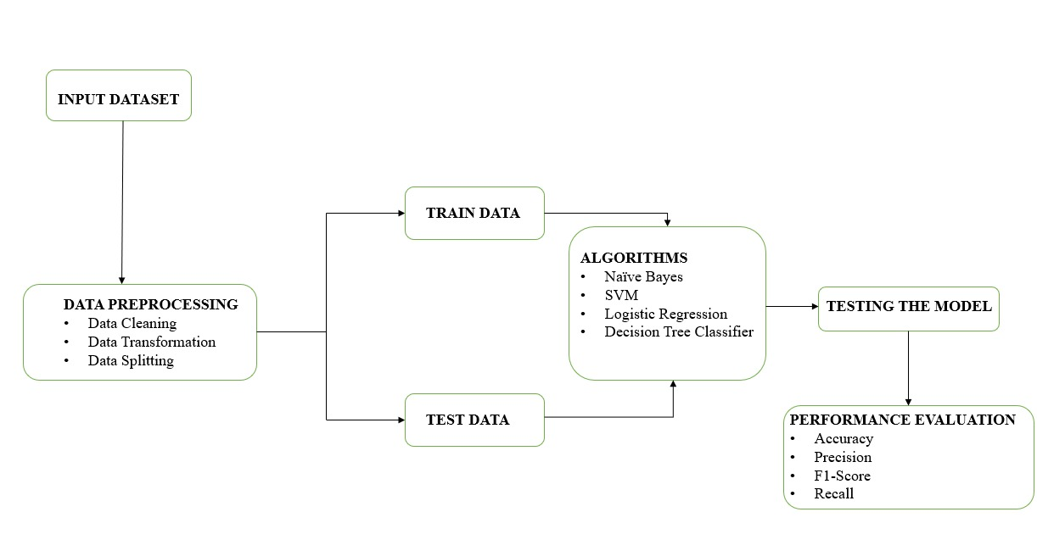
ARCHITECTURE

Slide 9
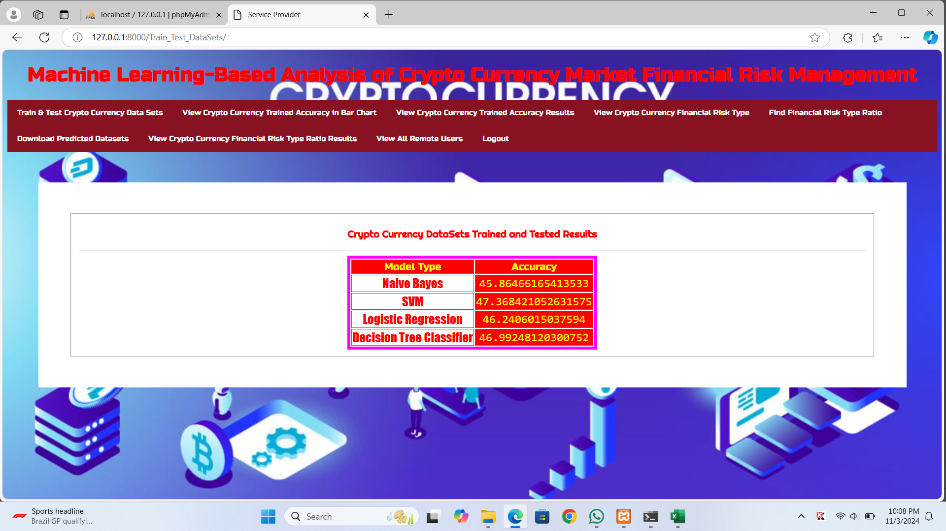
RESULT
This model able to predict the risk management using following machine learning algorithms and techniques.

Slide 10
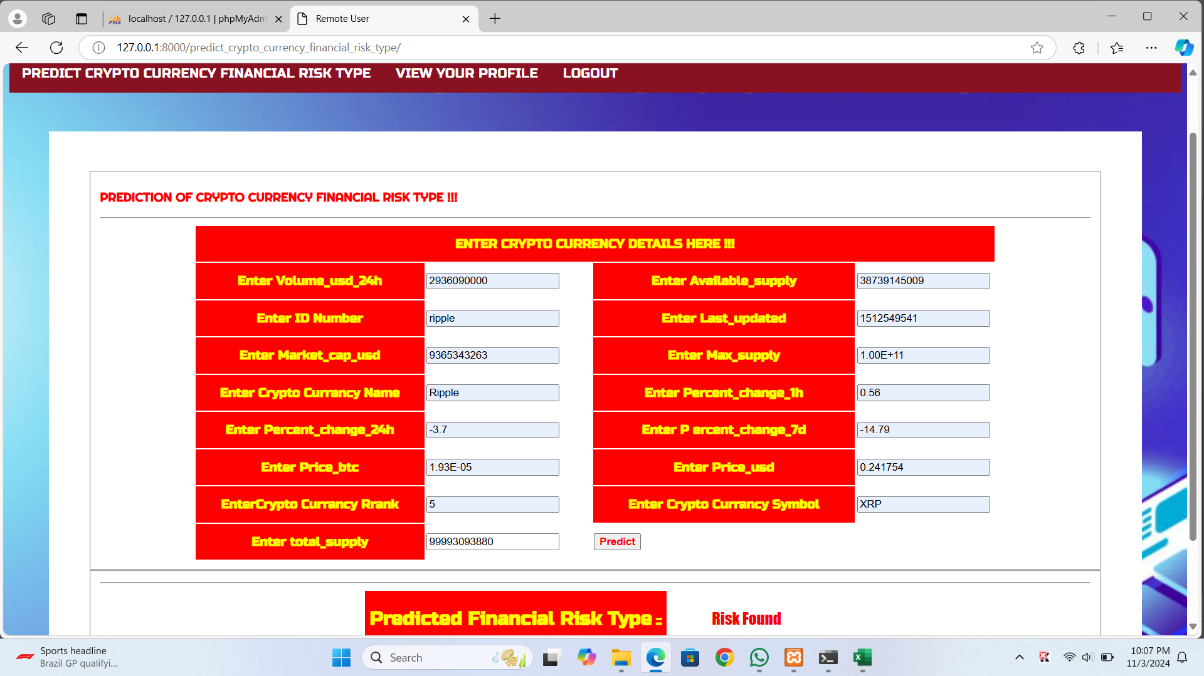
.
The model able to predict the cryptocurrency risk management by the following data.

Slide 11
CONCLUSION
The risk management of crypto currency network analysed using Naive bayes, Support vector machine, Logistic regression and Decision tree classification model technique and asset allocation method named as Hierarchical Risk Parity (HRP) that applied in crypto currencies portfolio.
Naive bayes and Support vector machine gives a high performance evaluation results as compare to other machine learning techniques have been used in this area.
The main reason of applying Naive bayes and Support vector machine in this process because of their different strengths in handling financial data, which can be noisy, unpredictable, and nonlinear. It gives the opportunity to system structure to get the high accuracy in term of providing the quality datasets.

Slide 12
FUTURE ENHANCEMENT
Incorporating More Advanced Machine Learning Models
Expanding the Risk Metrics
Real-Time Data Processing and Prediction
Enhanced Security Features

Slide 13
THANK YOU

